Slide 1
Impact of Parameters on Pairwise Alignment Quality
Term Project B
Lucas Damler

Slide 2
Purpose
See how different parameters change the quality of computed alignment using BLASTZ

Slide 3

Parameters
C – 0, 5
K – threshold for MSPs, alignment cutoff
K = 2000, 3000, 5000
O - open-gap penalty
O = 300, 500
T
0 – W-bp words
1 – 12of19
2 – 12of19 without transitions
W – word size (only when T = 0)
W = 8 (default), 12, 20
Length of an exact sequence match as start region for the final alignment

Slide 4
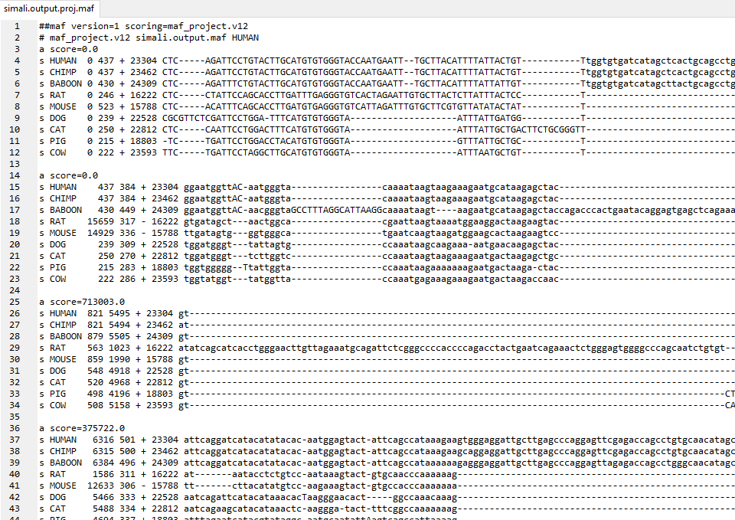
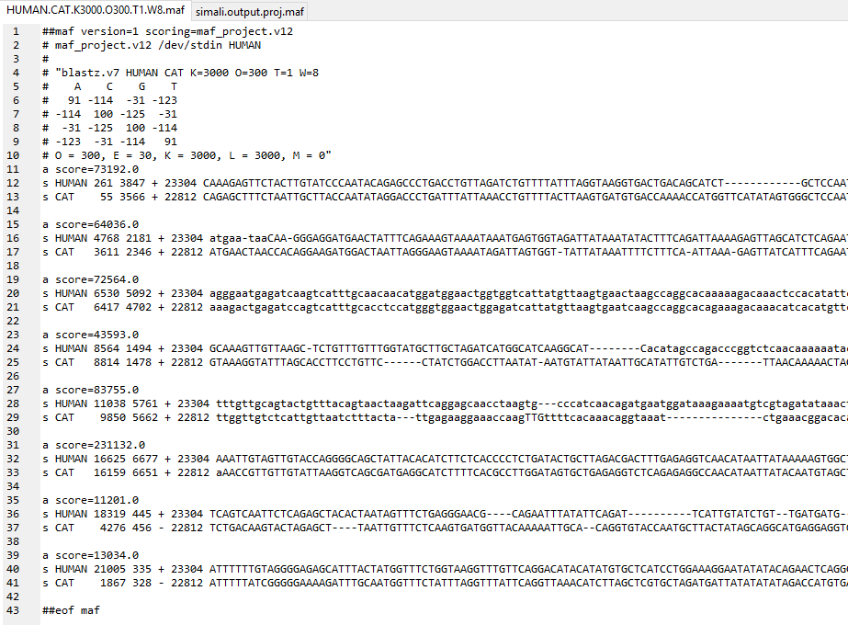
Input File Format
True Alignment
Computed Alignment

Slide 5
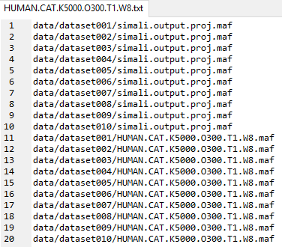
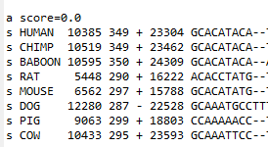
How the program works
Loops through and opens each file with the same name in each dataset
Opens file and searches for name of species being compared to human
Ex.) HUMAN.CAT.K2000.O500.T0.W20.maf
In true alignment makes sure each alignment block has a search species
Removes if no pair
Finds inversions and transforms position
Stores all values in vector
Loops through vector to compute true alignment array
Compares true alignment array to computed alignment array

Slide 6
Results
Chimp / Baboon
Cat / Dog
Cow / Pig
Mouse / Rat
Best sensitivity: 95/99%
K2000.O500.T0.W20
Best Specificity: 98/99%
K5000.O500.T0.W20
Worst Sensitivity: 95/99%
K3000.O300.T1.W8
Worst Specificity: 93/98%
K3000.O300.T1.W8
Best sensitivity: 68/69%
K2000.O500.T1.W8
Best Specificity: 92/89%
K5000.O500.T0.W20
Worst Sensitivity: 51/34%
K5000.O500.T0.W20
Worst Specificity: 75/90%
K3000.O300.T1.W8
Best sensitivity: 66/71%
K2000.O300.T1.W8
Best Specificity: 88/91%
K5000.O500.T0.W20
Worst Sensitivity: 36/52%
K5000.O500.T0.W20
Worst Specificity: 69/74%
K2000.O300.T1.W8
Best sensitivity: 37/34%
K2000.O300.T1.W8
Best Specificity: 85/86%
K2000.O500.T0.W20
Worst Sensitivity:1/0%
K5000.O500.T0.W20
Worst Specificity: 10/0%
K5000.O300.T0.W20
Animals in the same order are affected similarly by parameter changes

Slide 10
Conclusion For Best Alignment Results
For primate genomes
Low/High K, High O, T = 0, High W
Doesn’t really matter though because of inherent similarities
For cat and dog genomes
Sensitivity: Low K, High O, High T
Specificity: High K, High O, T = 0, High W
For cow and pig genomes
Sensitivity: Low K, Low O, High T
Specificity: High K, High O, T = 0, High W
For mouse and rat genomes
Sensitivity: Low K, Low O, High T
Specificity: Low K, High O, T = 0, High W

Slide 11
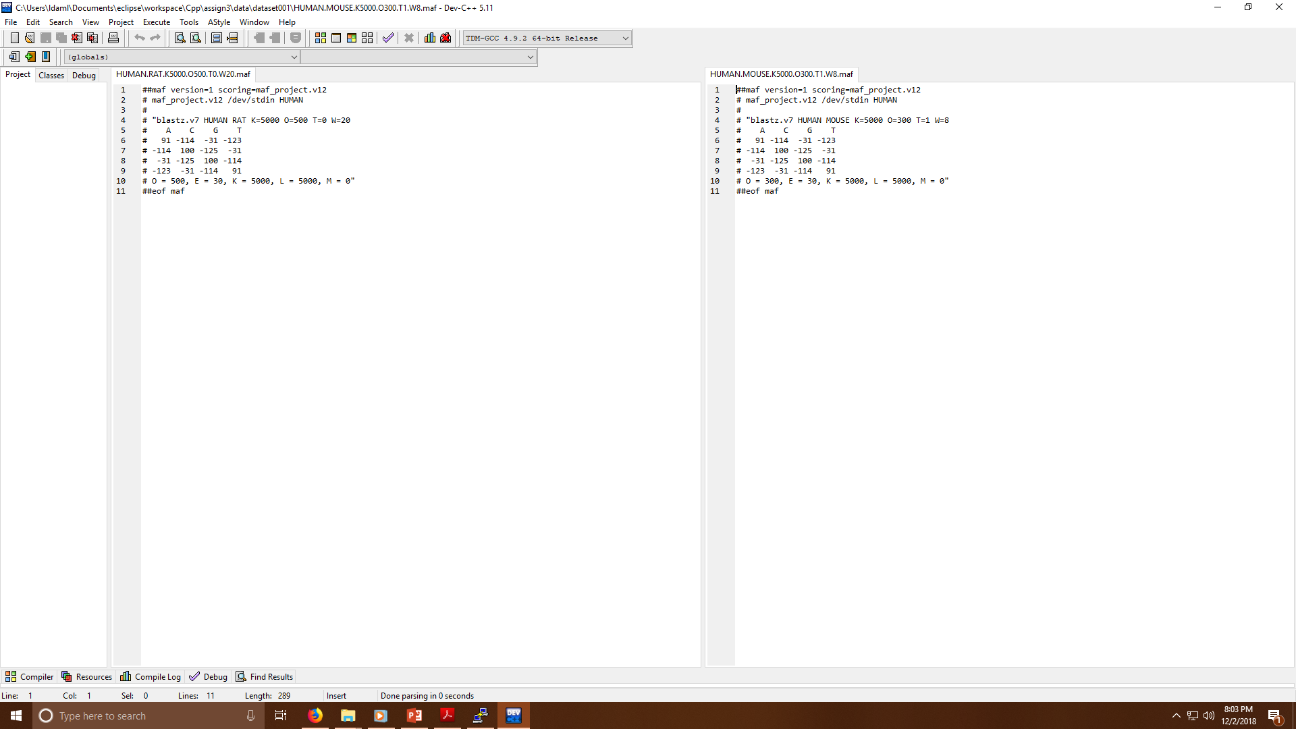
Problems Using Blastz
BLASTZ has a problem with premature alignment termination
BLASTZ chaining had a problem that caused it to discard very high-scoring HSPs
Rat and mouse maf files

